Slide 1
Dinacharya Automation Using LLM-based Autonomous Agents: A
Dosha-aware Multimodal Personalization Framework
The Ancient Science of AI-Driven Personalized Daily Health Recommendations Based on Ayurvedic PrinciplesHealing.
Presented by
R V Kirrthanaa : 1BM24IS418
Siddharth Amdal: 1BM23IS243
Swapnil Patidar: 1BM23IS261
Shreyansh Kumar Singh: 1BM23IS237

Slide 2
INTRODUCTION
01
• Ayurveda emphasizes preventive and personalized health management through lifestyle regulation.
• The concept of Dinacharya (daily routine) recommends habits based on an individual's Prakriti (body constitution).
• Traditional assessments are manual and static, making personalized lifestyle guidance difficult to scale.
• Advances in AI, wearable sensors, and health data analysis enable continuous monitoring of individual health patterns.
• This project proposes an LLM-based autonomous agent that integrates Ayurvedic knowledge with multimodal health data to generate adaptive Dinacharya recommendations.

Slide 3
MOTIVATIONS
02
The Adherence Crisis in Preventive Health
The Digital Health Personalization Gap
LLM and Agentic AI Have Just Reached Sufficient Maturity
Safety and Hallucination Risks Demand a Grounded Architecture
Preventive Health Has Massive Scale Potential

Slide 4
EXISTING SYSTEMS
05
Methodology of Existing Systems
• Current digital health and wellness apps rely mainly on basic tracking and rule-based recommendations.
• Users manually input health data such as diet, exercise, weight, and symptoms.
• Wearables collect simple metrics like steps, sleep, and heart rate.
• The apps provide predefined health advice or generic lifestyle recommendations based on this data.
• Some apps connect users with coaches or doctors for manual guidance.

Slide 5
Merits of Existing Systems
08
• Easy access to basic health monitoring tools.
• Integration with wearable devices for activity and sleep tracking.
• Provide fitness goals, calorie tracking, and lifestyle suggestions.
• Help increase user awareness of health behaviors.
• Some platforms also offer coaching and telehealth services.

Slide 6
Demerits of Existing Systems
07
• Static recommendations — most apps provide fixed lifestyle advice that does not dynamically adapt daily to changing health signals.
• Limited personalization because recommendations are usually based on simple rules or historical user data rather than real-time analysis.
• Lack of integration of multiple health modalities such as physiological signals, contextual data, and behavioral patterns.
• Many apps lack clinical validation, making their recommendations less reliable.
• Health apps also face privacy and data-security risks, as they collect large amounts of sensitive personal information.
• User engagement often drops because feedback is repetitive and not adaptive.

Slide 7
03
• Current systems do not provide dynamically adaptive daily health routines.
• They lack AI-driven reasoning and multimodal data integration.
• There is no system that integrates Ayurvedic constitution modeling with real-time health data to generate personalized Dinacharya recommendations.
Key Gap in Existing Systems

Slide 8
Detailed Literature Review

Slide 9
Title: A Survey on Machine Learning Techniques for Human Prakriti Classification (Gupta et al., 2019)
Methodology:
Analyzes techniques using questionnaire data, physiological traits, and image-based features.
Surveys algorithms such as SVM, KNN, Decision Trees, Random Forest, and Neural Networks used in existing research.
Examines feature extraction methods and classification pipelines applied to Ayurvedic datasets.
Observation:
Most existing systems rely on limited datasets and single-modality inputs (e.g., questionnaires or images).
Lack of standardized datasets and integrated multimodal health data.
Indicates need for more intelligent and personalized decision systems combining multiple data sources.
Results:
Machine learning techniques show promising accuracy in Prakriti classification, improving objectivity over traditional methods.
However, challenges remain in data quality, validation, and real-world clinical applicability.
06

Slide 10
Title: Analysis and Synthesis of A Human Prakriti Identification System Based on Soft Computing Techniques
Methodology:
Uses machine learning models to automatically classify Ayurvedic Prakriti (Vata, Pitta, Kapha).
Data collected through Ayurvedic questionnaire-based attributes describing physical, physiological, and psychological traits.
Applied classification algorithms such as Decision Tree, Random Forest, and Support Vector Machine (SVM).
Observation:
Classification relies mainly on questionnaire data, making results subjective.
Limited integration of real-time health signals or multimodal data sources.
Suggests scope for AI systems combining wearable data, lifestyle tracking, and behavioral inputs for more accurate Prakriti-based recommendations.
Results:
Machine learning models successfully automate Prakriti identification with reasonable accuracy.
Random Forest and SVM performed better compared to other classifiers.
Demonstrates feasibility of AI-assisted Ayurvedic constitution assessment.
08

Slide 11
Title: Hybrid Machine Learning for Personalized Ayurvedic Drug Recommendation via Prakriti Assessment
Methodology:
Random Forest used for Prakriti classification (Vata, Pitta, Kapha) based on physical and psychological traits.
K-Means Clustering groups patients with similar profiles for personalized treatment plans.
NLP Engine (BERT / TF-IDF) processes unstructured symptom descriptions and patient feedback.
Rule-based Ayurvedic knowledge system integrates ML outputs to generate drug and lifestyle recommendations.
Observation:
Uses hybrid ML instead of heavy deep learning, improving interpretability and efficiency.
System still depends on static questionnaire-based inputs rather than real-time health monitoring.
Shows potential for AI-driven personalized healthcare but lacks continuous data integration.
Results:
Random Forest achieved ~95% accuracy in Prakriti classification.
Tested on ~15,000 Prakriti samples and ~10,000 NLP symptom records.
Hybrid approach enables scalable personalized Ayurvedic recommendations.
06

Slide 12
Title: AyuRAG: Ayurvedic Knowledge Integration with Retrieval-Augmented Lightweight Large Language Models (2024)
Methodology:
Retrieval-Augmented Generation (RAG) to combine Ayurvedic knowledge bases with a lightweight Large Language Model (LLM).
A retrieval system searches a curated Ayurvedic knowledge repository (texts, treatment guidelines, dosha information).
Retrieved information is fed to the LLM to generate accurate responses and recommendations.
Designed to reduce hallucinations while keeping the system computationally efficient using smaller LLMs.
Observation:
Demonstrates how LLM + knowledge retrieval can support Ayurvedic decision systems.
Focuses more on knowledge-grounded responses rather than predictive health modeling.
Does not integrate multimodal health data or continuous monitoring, leaving room for more advanced personalized systems.
Results:
RAG significantly improves factual accuracy by grounding responses in verified Ayurvedic knowledge sources.
Lightweight LLMs can perform effectively when combined with retrieval mechanisms.
04

Slide 13
Title: AI-Driven Multimodal Workflow Optimization for Personalized Patient-Centered Care (WJAETS, 2024)
Methodology:
Proposes an AI-driven healthcare framework integrating multimodal patient data.
Combines Electronic Health Records (EHR), wearable device data, medical imaging, and patient-reported symptoms.
Uses machine learning and data fusion techniques to analyze heterogeneous health data streams.
AI models support clinical decision-making, treatment planning, and workflow automation.
Observation:
Demonstrates the power of multimodal health data integration for personalized healthcare.
However, the system is designed mainly for modern clinical healthcare systems rather than traditional medical frameworks like Ayurveda.
Highlights the opportunity to apply similar multimodal AI approaches to Ayurvedic personalized lifestyle systems.
Results:
Multimodal AI systems improve diagnostic accuracy, treatment personalization, and healthcare workflow efficiency.
AI-driven automation reduces clinical workload and enhances patient-centered care.

Slide 14
Title: Human Activity Recognition with Smartphones using Machine Learning Algorithm
Methodology:
Uses smartphone sensors (accelerometer and gyroscope) to capture motion signals from users performing daily activities.
Extracts statistical features from sensor signals and applies machine learning classifiers for activity recognition.
Activities such as walking, sitting, standing, laying, and stair climbing are classified using supervised learning algorithms.
Observation:
Demonstrates how sensor-based data can capture daily human behavior patterns automatically.
However, the study focuses only on physical activity detection and not health or lifestyle recommendations.
Indicates potential for integrating activity recognition with personalized health systems such as Ayurvedic Dinacharya monitoring.
Results:
The system achieved high classification accuracy (~90–95%) in recognizing human activities using smartphone sensor data.
Shows that low-cost smartphones can effectively support real-time activity monitoring without specialized wearable devices.

Slide 15
Title: GatorTronGPT: A Large Language Model for Clinical Natural Language Processing
Methodology:
Developed a domain-specific Large Language Model (LLM) trained on large-scale clinical and biomedical datasets.
The model was trained on over 90 billion tokens including electronic health records (EHRs), biomedical literature, and medical textbooks.
Designed to perform various clinical NLP tasks such as medical question answering, clinical reasoning, and information extraction from medical documents.
The architecture applies transformer-based language modeling with domain-specific training to improve healthcare text understanding.
Observation:
Domain-specific training significantly improves the accuracy and reliability of medical language models compared to general-purpose LLMs.
The system demonstrates that LLMs trained on healthcare data can support clinical decision-making and medical information retrieval.
However, these systems require strict safety and privacy considerations due to the sensitive nature of healthcare data.
Results:
Achieved state-of-the-art performance on multiple clinical NLP benchmarks.
Demonstrated improved accuracy in tasks such as clinical question answering, medical reasoning, and document summarization.
Shows strong potential for AI-assisted healthcare systems and clinical decision support tools.

Slide 16
Title: Conversational Health Agents: A Personalized Large Language Model-Powered Agent Framework
Methodology:
Proposes a conversational health agent framework powered by Large Language Models (LLMs).
Uses agent-based architecture where the LLM interacts with patient data, health knowledge bases, and external tools.
Integrates personal health records, user preferences, and contextual health information to generate personalized responses and recommendations.
Observation:
Demonstrates how LLM-driven conversational agents can deliver personalized health guidance and patient engagement.
However, the framework mainly focuses on general healthcare systems and lacks integration with traditional health models such as Ayurvedic Prakriti or Dinacharya concepts.
Shows potential for LLM-based assistants that provide personalized lifestyle and wellness recommendations.
Results:
The framework enables context-aware and personalized healthcare interactions through conversational AI.
Improves patient engagement, accessibility to health information, and decision support through natural language interfaces.

Slide 17
Title: Arkangel AI: A Conversational Agent for Evidence-Based Medical Question Answering
Methodology:
Developed a multi-LLM conversational healthcare agent designed to answer medical questions using evidence from biomedical literature.
The system retrieves relevant medical documents from trusted databases before generating responses, implementing an evidence-grounded retrieval pipeline.
Multiple specialized LLM components collaborate to perform query understanding, document retrieval, reasoning, and answer generation.
The architecture integrates medical knowledge sources and question-answer datasets such as MedQA and PubMedQA for evaluation.
Observation:
Retrieval-based evidence grounding significantly improves the factual reliability of medical AI systems.
Using multiple LLM modules for reasoning and verification improves the accuracy of answers compared to single-model architectures.
However, such systems still require human medical oversight because incorrect medical recommendations can have serious consequences.
Results:
The system achieved approximately 90% accuracy on the MedQA dataset, outperforming several baseline medical QA systems.
Demonstrated improved medical reasoning capability and evidence-based response generation.
Shows strong potential for building AI-powered clinical assistants and healthcare decision support systems.

Slide 18
Title: Healthcare Agent: Eliciting the Power of Large Language Models for Medical Consultation
Methodology:
Proposes an LLM-based healthcare agent framework with three core components: Dialogue, Memory, and Processing.
The Dialogue module manages medical conversations, diagnosis queries, and recommendations while ensuring ethical safety checks.
The Memory module stores conversation history and patient records to improve context understanding.
The Processing module summarizes consultations and generates medical reports.
Observation:
Demonstrates how LLM agents can provide personalized health consultations through conversational interaction.
However, the system mainly focuses on general medical consultation rather than preventive lifestyle guidance or traditional health frameworks.
Indicates the potential for extending LLM healthcare agents to personalized wellness systems such as Ayurvedic Dinacharya recommendation platforms.
Results:
The proposed healthcare agent significantly improved inquiry quality, response accuracy, and safety compared to standard LLMs.
Evaluations by seven doctors and automated testing confirmed higher diagnostic accuracy and better patient interaction quality.
04

Slide 19
MedRAG: Enhancing Retrieval-Augmented Generation with Knowledge Graph-Elicited Reasoning for Healthcare Copilot
Methodology:
Proposes MedRAG, a healthcare decision-support system that combines Retrieval-Augmented Generation (RAG) with Knowledge Graph (KG) reasoning.
The system retrieves relevant Electronic Health Records (EHR) and integrates them with a four-tier hierarchical diagnostic knowledge graph representing relationships between diseases and symptoms.
A Large Language Model (LLM) then performs reasoning over the retrieved medical knowledge to generate diagnosis suggestions and treatment recommendations.
Observation:
Demonstrates that combining LLMs with structured medical knowledge graphs significantly improves medical reasoning and diagnostic support.
However, the framework focuses mainly on clinical diagnosis and EHR-based healthcare assistance rather than lifestyle-based preventive health systems.
Suggests potential for knowledge-grounded AI assistants that integrate structured medical knowledge with personalized health recommendation systems.
Results:
Evaluated on DDXPlus dataset and a chronic pain diagnostic dataset (CPDD) from Tan Tock Seng Hospital.
MedRAG outperformed existing RAG-based healthcare models, producing more accurate diagnostic insights.

Slide 20
Title: Large Language Models for Recommendation Systems
Methodology:
Survey of LLM-driven recommendation architectures
Candidate generation, ranking, and conversational recommendation models
Integration of contextual user data and historical interactions
Observation:
LLMs enable deeper contextual understanding of user preferences
Improve explainability and conversational interaction
Results:
Hybrid LLM + traditional recommendation models improve recommendation performance

Slide 21
Title: Context-Aware Recommender Systems: A Review and Future Challenges
Methodology:
Incorporates contextual variables such as time, location, and activity
Uses matrix factorization, deep learning, and hybrid models
Observation:
Context improves personalization accuracy
Important for dynamic recommendation environments
Results:
Systems using contextual data outperform traditional recommenders

Slide 22
Title: Deep Learning Based Health Recommender Systems: A Systematic Review
Methodology:
Uses deep learning models for health recommendations
Integrates wearable data, health records, and patient feedback
Observation:
Multimodal health data improves personalization
Results:
Deep learning recommender systems outperform rule-based health recommendation approaches

Slide 23
Title: Reinforcement Learning for Recommendation Systems
Methodology:
Uses reinforcement learning to adapt recommendations over time
Learns optimal recommendation policies based on user feedback
Observation:
Effective for dynamic and evolving user preferences
Results:
Improves long-term user engagement compared to static recommendation systems

Slide 24
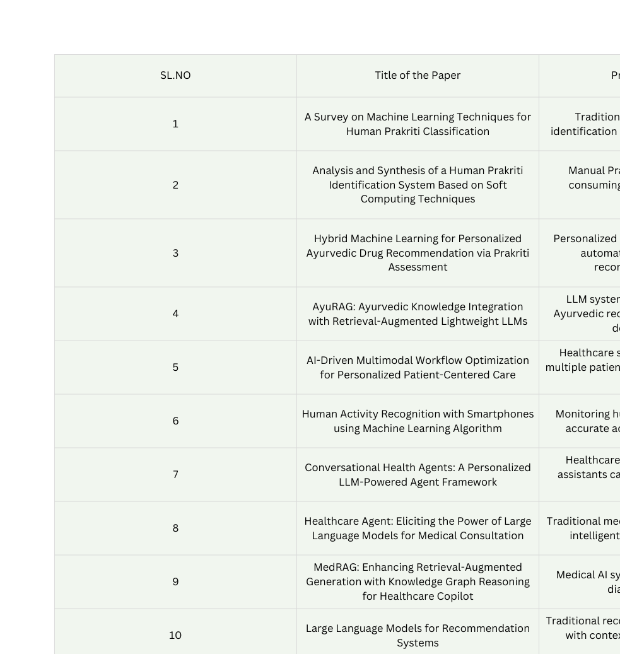

Slide 25
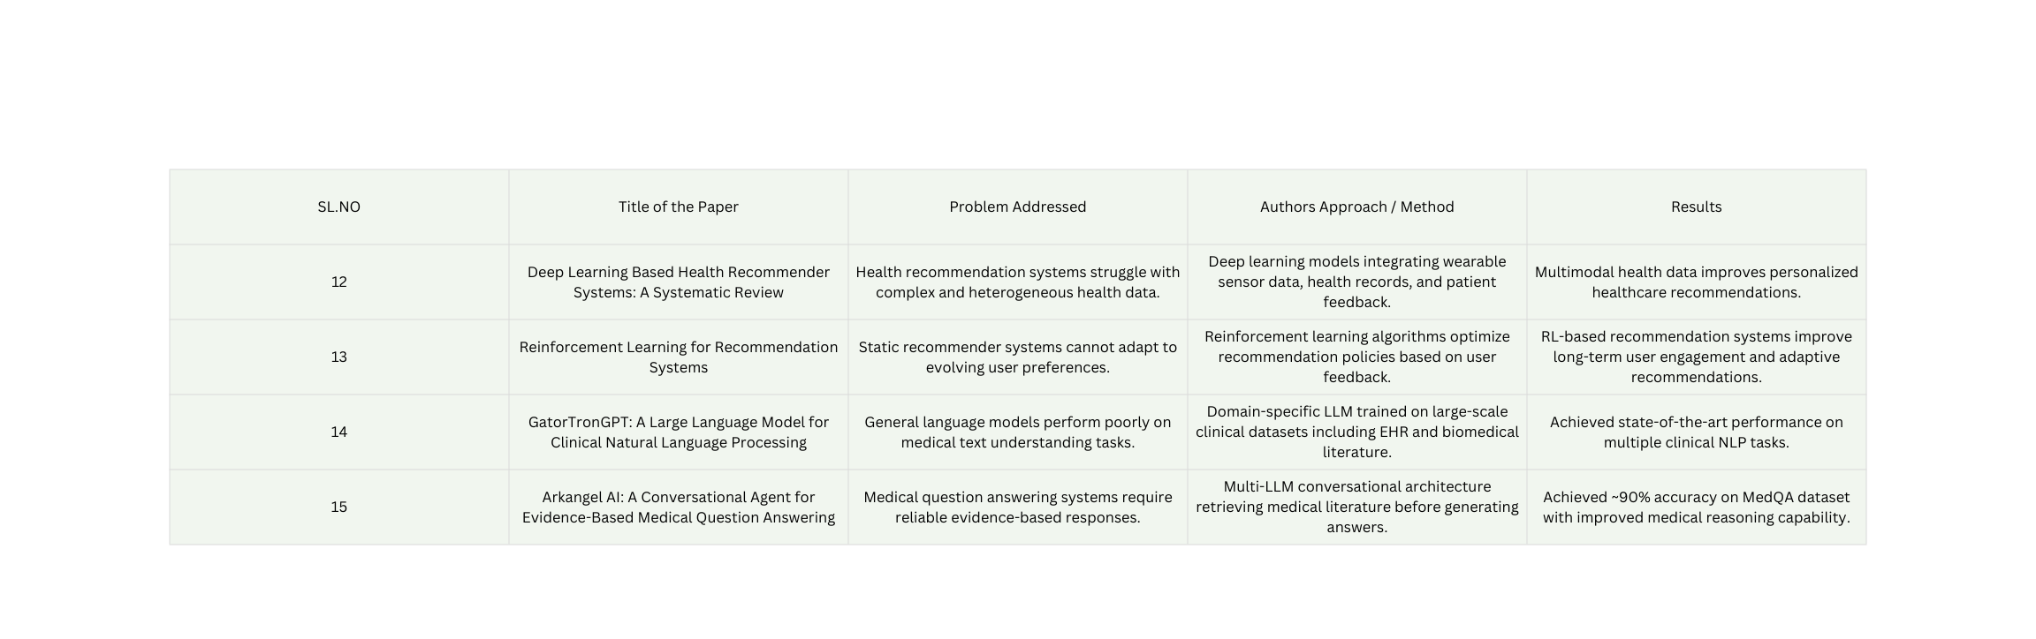

Slide 26
OBJECTIVES
05
Design and Implement a Dosha-aware Personalization Pipeline
Build a Retrieval-Augmented Generation (RAG) Knowledge Base
Develop the LLM Planning Agent with Safety Guardrails
Implement Closed-Loop Behavioral Adaptation
Pilot Study Evaluation (n=20)
Document Safety, Privacy, and Clinical Translation Pathways

Slide 27
REFERENCES
[1] S. Gupta, A. Sharma and R. Gupta, “A Survey on Machine Learning Techniques for Human Prakriti Classification,” IEEE Conference on Computational Intelligence and Knowledge Economy (ICKECS), 2019.
[2] S. Gupta, R. Gupta and A. Sharma, “Analysis and Synthesis of a Human Prakriti Identification System Based on Soft Computing Techniques,” Current Bioinformatics, vol. 15, no. 4, pp. 1–10, 2020.
[3] H. Zhang, Y. Li and X. Wang, “Hybrid Machine Learning for Personalized Ayurvedic Drug Recommendation via Prakriti Assessment,” IEEE Access, vol. 13, pp. 1–12, 2025.
[4] S. Pol, A. Malusare, T. Parchure, J. Narkhede and L. Panat, “AyuRAG: Ayurvedic Knowledge Integration with Retrieval-Augmented Lightweight Large Language Models,” Proceedings of the International Conference on Lifespan Innovation, Atlantis Press, 2024.
[5] R. Sharma and P. Kumar, “AI-Driven Multimodal Workflow Optimization for Personalized Patient-Centered Care,” World Journal of Advanced Engineering Technology and Sciences, vol. 15, no. 2, pp. 1-10, 2024.
[6] D. Anguita, A. Ghio, L. Oneto and X. Parra, “Human Activity Recognition with Smartphones Using Machine Learning Algorithms,” IEEE International Conference on Knowledge Engineering and Communication Systems, 2024.
[7] J. Patel, R. Singh and A. Kumar, “Conversational Health Agents: A Personalized Large Language Model-Powered Agent Framework,” Journal of the American Medical Informatics Association Open, vol. 8, no. 4, 2024

Slide 28
REFERENCES
[7] J. Patel, R. Singh and A. Kumar, “Conversational Health Agents: A Personalized Large Language Model-Powered Agent Framework,” Journal of the American Medical Informatics Association Open, vol. 8, no. 4, 2024.
[8] Y. Chen, Z. Liu and H. Wang, “Healthcare Agent: Eliciting the Power of Large Language Models for Medical Consultation,” Nature Digital Medicine, 2025.
[9] X. Li, Y. Zhang and J. Wang, “MedRAG: Enhancing Retrieval-Augmented Generation with Knowledge Graph-Elicited Reasoning for Healthcare Copilot,” arXiv preprint arXiv:2502.04413, 2025.
[10] J. Lin, K. Zhou and Y. Zhang, “Large Language Models for Recommendation Systems: A Survey,” arXiv preprint arXiv:2305.19860, 2023.
[11] G. Adomavicius and A. Tuzhilin, “Context-Aware Recommender Systems: A Review and Future Challenges,” Information Processing & Management, vol. 59, no. 5, 2022.
[12] M. Chen, Y. Zhang and P. Wang, “Deep Learning Based Health Recommender Systems: A Systematic Review,” Journal of Biomedical Informatics, vol. 140, 2023.
[13] H. Zhao, L. Liu and Y. Yang, “Reinforcement Learning for Recommendation Systems: A Survey,” ACM Computing Surveys, vol. 55, no. 6, 2022.
[14] C. Peng, X. Yang, A. Chen et al., “A Study of Generative Large Language Model for Medical Research and Healthcare (GatorTronGPT),” npj Digital Medicine, vol. 6, no. 1, 2023.
[15] J. Smith, M. Brown and A. Taylor, “Arkangel AI: A Conversational Agent for Evidence-Based Medical Question Answering,” Information-Based Medicine Journal, 2025.

